Slide 1
Learn Data Science by Doing Kaggle Competitions Meetup Vancouver, BC
By Stan Kriventsov
October 1, 2020
Please check out my site https://dl.reviews

Slide 2
Part 1. Competition Rules and Data Overview

Slide 3
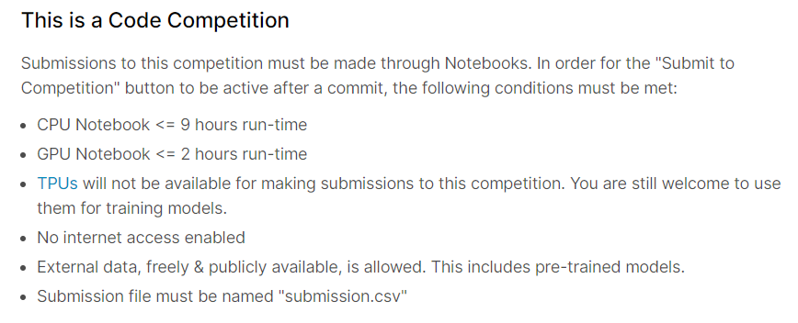
Competition rules

Slide 4
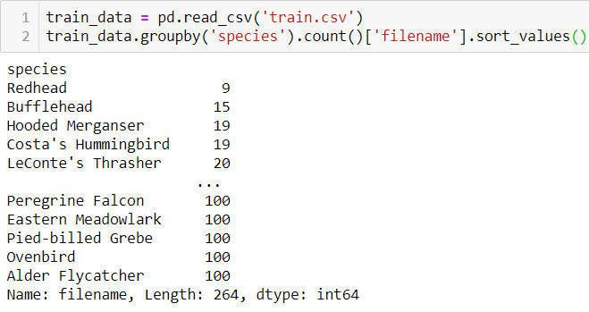
Train data:
21,375 mp3 bird call recordings, 264 different birds
Labels are weak – no time information, which makes the problem harder

Slide 5
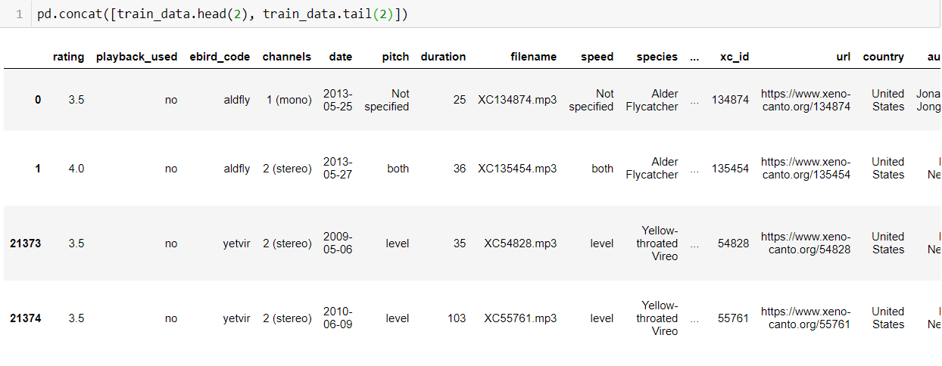
Train data:
21,375 mp3 bird call recordings, 264 different birds
See https://www.kaggle.com/andradaolteanu/birdcall-recognition-eda-and-audio-fe for more

Slide 6
Test data:
~150 mp3 bird call recordings (?), each about 10 minutes long
Only few samples provided in advance
Longer recordings with multiple birds and background noise
Need to identify birds during specific time intervals (two 5-second intervals per file) as well as for the whole file

Slide 7
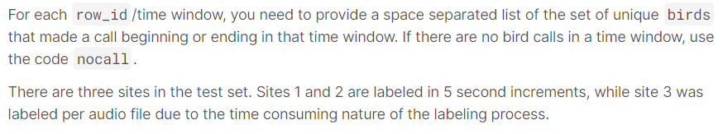
Evaluation metric:
row-wise micro-averaged F1 score

Slide 8
Row-wise micro-averaged F1 score
For one class:
For multi-class predictions:
Macro-averaged F1 Score: mean of F1 for each class
Weighted-averaged F1 Score: weighted mean using number of TP
Micro-averaged F1 Score: combine all classes when calculating TP, FP, FN
More at https://towardsdatascience.com/multi-class-metrics-made-simple-part-ii-the-f1-score-ebe8b2c2ca1
From https://stackoverflow.com/questions/35365007/tensorflow-precision-recall-f1-score-and-confusion-matrix

Slide 9
Part 2. Theory and Research Ideas Used by Winners

Slide 10
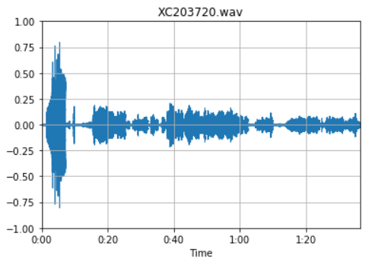
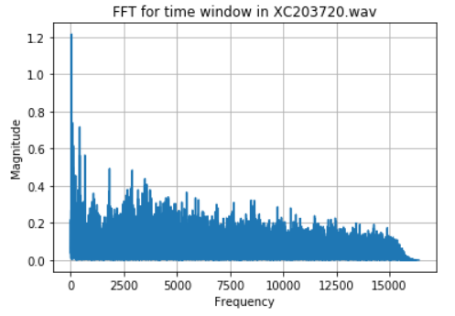
Representations of Audio
Time domain
Frequency domain for a short window

Slide 11
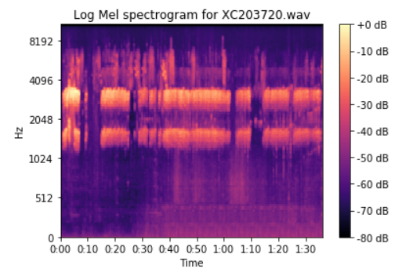
Log MEL Spectrograms:
2D Representation of Audio
MEL Frequency Scale consists of n bins (in this case n = 128) corresponding to intervals that are approximately equidistant to a human ear
Bin width in Hz depends on the frequency, e.g. the distance between 500 and 1000 Hz is similar to that between 5000 and 10000Hz (approximately logarithmic)
Can be easily generated using librosa (or torchlibrosa).

Slide 12
Using Log MEL Spectrograms as images for prediction
Basic idea: use Transfer Learning by fine-tuning visual models pretrained on ImageNet or a specialized audio dataset to make predictions

Slide 13
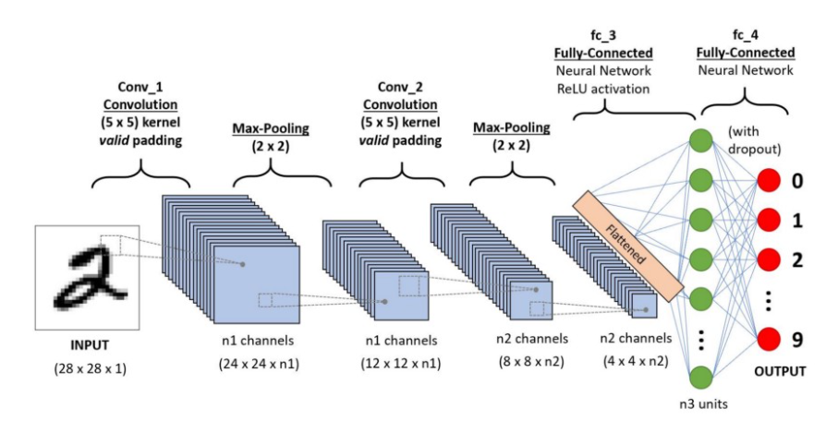
Convolutional Neural Nets
Image from https://towardsdatascience.com/a-comprehensive-guide-to-convolutional-neural-networks-the-eli5-way-3bd2b1164a53

Slide 14
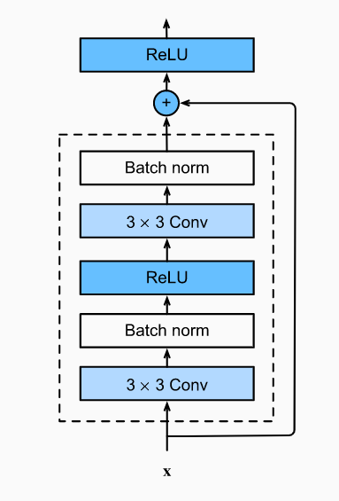
ResNet (ResNext, ResNest, etc)
Consists of multiple residual blocks (see image)
Each block has a residual connection that goes around the main part and adds the input signal to the output
Without the batch normalization layers, the signal would grow exponentially with number of blocks (2^{n})
With the batch norm layers, the signal grows linearly, and towards the end the residual part dominates. As a result, the signal in ResNets mainly flows through shallow paths
Deeper residual networks provide greater combinatorial variety in the number of paths, thus increasing the chance of “winning the lottery” with a good combination of weights
Image from http://d2l.ai/chapter_convolutional-modern/resnet.html

Slide 15
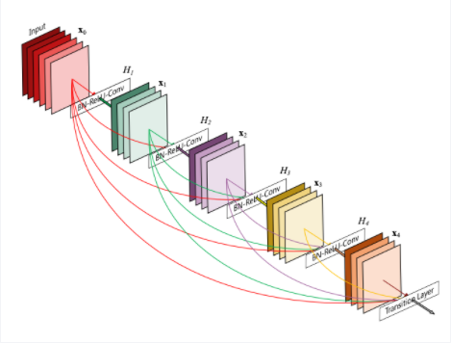
DenseNet
Similar to ResNet, but skip (residual) connections extend around multiple blocks
Image from https://pytorch.org/hub/pytorch_vision_densenet/

Slide 16
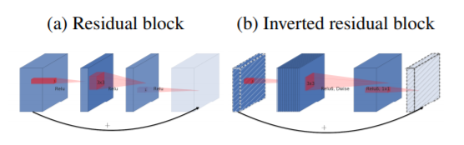
MobileNetv2 (Inverted Residual Blocks)
In the picture, the thickness of each block indicates number of channels. In inverted residual blocks, the residual connection is between introduced linear (without activation) bottleneck layers (blocks with fewer channels), which reduces the number of parameters. Also, depthwise separable convolutions are used with the same goal.
Image from https://arxiv.org/pdf/1801.04381.pdf

Slide 17
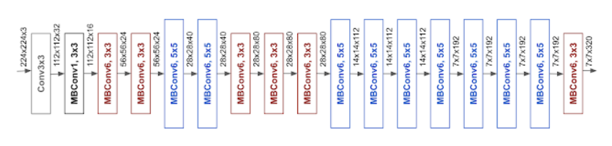
EfficientNet (Google, 2019)
Architecture determined by Neural Architecture Search with the goal of maximizing the efficiency. Comes in different sizes: B0 (5.3M parameters) - B7 (66M parameters)
Mostly consists of MBConv blocks (inverted residual blocks) from MobileNetv2 (previous slide)
Image from https://ai.googleblog.com/2019/05/efficientnet-improving-accuracy-and.html

Slide 18
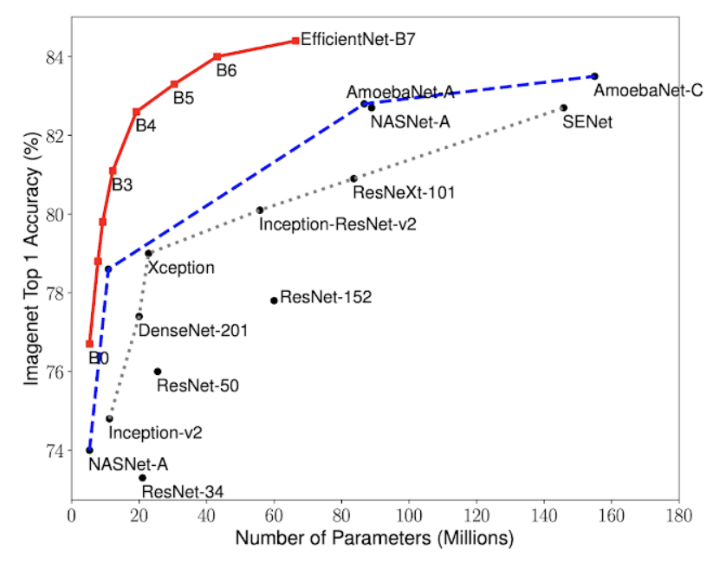
EfficientNet (Google, 2019)
Image from https://ai.googleblog.com/2019/05/efficientnet-improving-accuracy-and.html

Slide 19
Common Audio Domain ML Tasks
Audio tagging
Acoustic scene classification
Music classification
Speech emotion classification
Sound event detection
Etc

Slide 20
Pretrained Neural Networks for Audio Tasks
2019 paper “PANNs: Large-Scale Pretrained Audio Neural Networks for Audio Pattern Recognition” by Qiuqiang Kong et al, University of Surrey, UK and ByteDance AI Lab: https://arxiv.org/abs/1912.10211
Code & pretrained models:
https://github.com/qiuqiangkong/audioset_tagging_cnn
https://zenodo.org/record/3987831
Based on AudioSet dataset (https://research.google.com/audioset) a collection of about 2 million human-labeled 10-second sound clips drawn from YouTube videos with 632 classes

Slide 21
Sound Event Detection (SED) Framework
Competition notebook and kernel by Hidehisa Arai (6th place)
that was used by many of the winners:
https://www.kaggle.com/hidehisaarai1213/introduction-to-sound-event-detection
The framework is used to detect different sound events within each clip, with prediction of start time, end time, and the type of event. The start and end time are calculated using a self-attention layer applied to event probabilities at each point in time. Special training schemes are used to localize bird sounds from weak labels.

Slide 22
Data Augmentation
Used to increase the amount of training data by slightly changing the existing data (e.g. rotations, flips, dilations, cropping, adding noise, etc in case of images) or generating synthetic data (GANs)
Only works if new data stays within the same distribution and corresponds to the same label

Slide 23
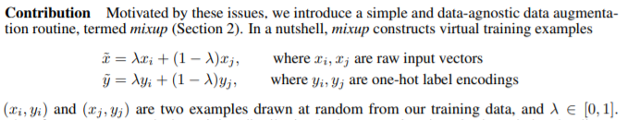
Mixup: A Simple Way to Augment Data
From 2017 paper “mixup: Beyond Empirical Risk Minimization” by Hongyi Zhang et al, MIT and Facebook AI Research: https://arxiv.org/abs/1710.09412
Mixup encourages the model to behave linearly between training examples, promoting smoothness and reducing undesirable oscillations.

Slide 24
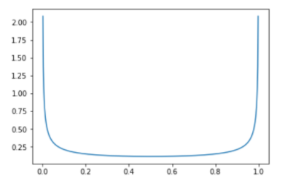
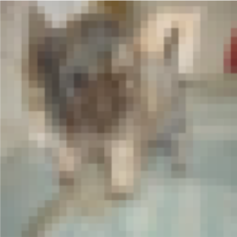
Mixup
Example:
70% dog, 30% cat
Beta distribution
Often used for picking λ values
From https://forums.fast.ai/t/mixup-data-augmentation/22764

Slide 25
Ensembling example
Have 3 independent classifiers, each 70% accurate
Combine their predictions by majority rule
70% * 70% * 70% = 34.3% all three correct
3 * 70% * 70% * 30% = 44.1% two correct
Ensemble accuracy: 34.3% + 44.1% = 78.4%!

Slide 26
Ensembling
A very popular technique in which the predictions of several diverse machine learning models are combined to improve upon the accuracy of each model
In many cases leads to a several percent increase in accuracy of predictions
The more different the models are, the better

Slide 27
Part 3. Competition Results

Slide 28
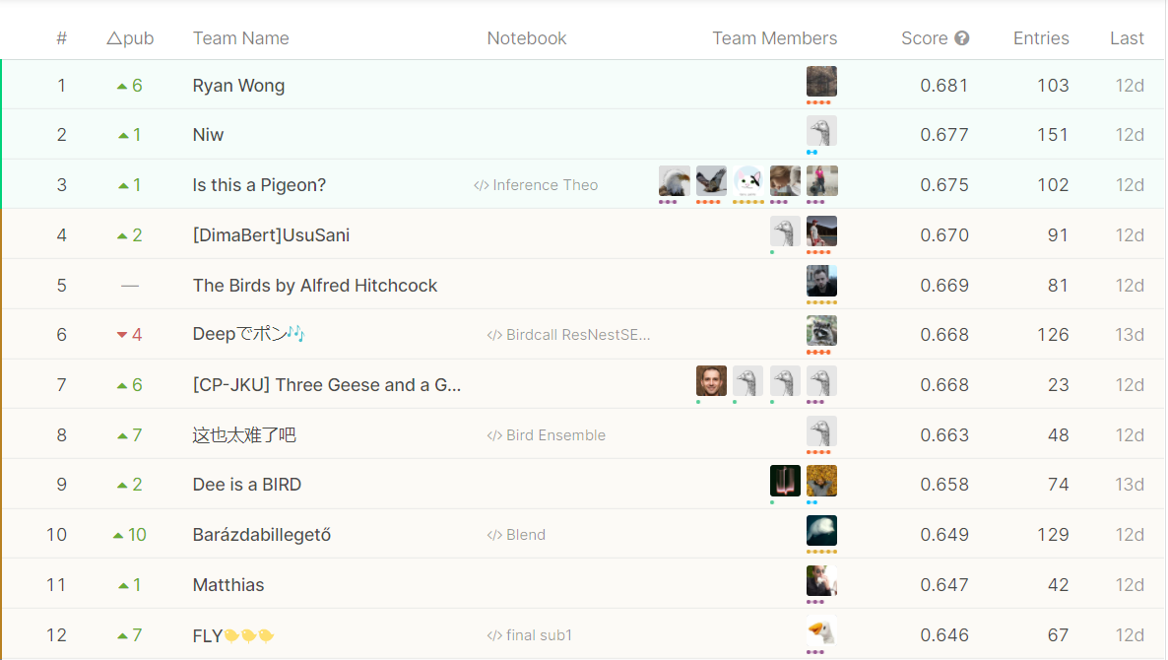
Final Leaderboard

Slide 29
1st Place Solution: Ryan Wong
Used SED approach, but switching CNN to a pretrained DenseNet 121
No external data, various audiomentations (Gaussian noise, pink noise, Gaussian SNR, volume adjustment)
Cosine Annealing with warmup
Ensemble of 13 models (with and without mixup) by a specifically designed voting scheme
Code: https://github.com/ryanwongsa/kaggle-birdsong-recognition

Slide 30
2nd Place Solution: Vladislav Kramarenko
Used SED with pretrained EfficientNet-b0, ResNet50, DenseNet121 (ensemble of 6)
Manually went through 20 thousand training files (!) and deleted large segments without the target bird
Used a lot of augmentations: mixup 1-3 files, raising image to power 0.5 to 3, faster/slower, added noise, lowered upper frequencies
Code: https://github.com/vlomme/Birdcall-Identification-competition

Slide 31
3rd Place Solution: Is this a Pigeon? (team of 5)
Ensemble of ResNext50, ResNext101, and ResNest50 models trained with additional external data
Augmentations (adding Gaussian and background noise, modified mixup, cropping)
Stratified 5-fold cross-validation
Custom ensembling formula
Code: https://github.com/TheoViel/kaggle_birdcall_identification

Slide 32
4th Place Solution: [DimaBert]UsuSani
Ensemble of 7 EfficientNets (B3, B4, B5) pretrained on noisy student, external data
Augmentations (gain, background noise, low frequency cutoff, mixup)
Cross-validation with multiple metrics
Code: https://www.kaggle.com/vladimirsydor/4-th-place-solution-inference-and-training-tips

Slide 33
6th Place Solution: Hidehisa Arai
Shared Sound Event Detection notebook that was used by all winners
3 stages of training to gradually remove noise in labels (weak and missing labels) by predicting on randomly cropped smaller chunks
Augmentations, cosine annealing
Stochastic weight averaging

Slide 34
Conclusions
All of the best results were achieved by standard 2D ConvNets (ResNet, DenseNet, EfficientNet) with Sound Event Detection framework
Augmentations, particularly mixup, are essential
As always in Kaggle, ensembling provides a small but important additional benefit, especially with a properly chosen voting scheme
If you want to win, never try to code everything from scratch, study public notebooks and borrow the best parts, and don’t share your best ideas ☺

Slide 35
The End
Questions?

Slide 36
Appendix

Slide 37
Noisy Student
From 2019 paper “Self-training with Noisy Student improves ImageNet classification” by Qizhe Xie et al, Google Research and CMU: https://arxiv.org/abs/1911.04252
A semi-supervised learning approach
First, a smaller teacher network is trained on labeled data
Then, the trained teacher network is used to label new data
Finally, a larger student network is trained on all data, with noise added (dropout, stochastic depth, random augmentations) to promote better generalization
Possibly make the student a new teacher and repeat

Slide 38
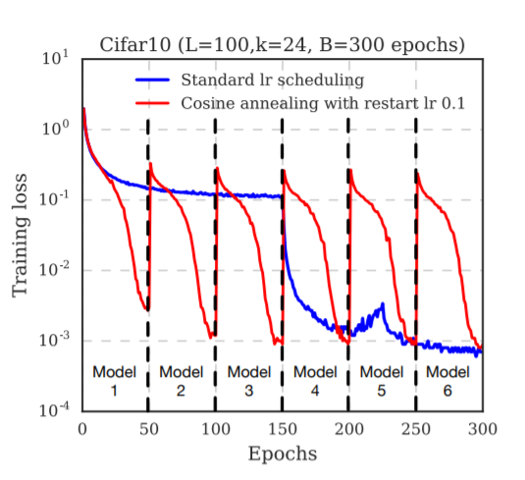
From 2017 paper “SNAPSHOT ENSEMBLES: TRAIN 1, GET M FOR FREE” by Gao Huang et al, Cornell Univ and Tsinghua Univ: https://arxiv.org/abs/1704.00109
A neural network is trained to a local minimum, the weights are saved, then the learning rate is increased and training continues until the next minimum, etc
Resulting models are ensembled for better accuracy
Cyclic Cosine Annealing

Slide 39
For faster convergence of the gradient descent algorithm, it is beneficial to have a higher learning rate at the start. However, this increases the chance that the training will not converge
A warm-up means that the learning rate is initially set a bit lower, for example, 0.1 in https://arxiv.org/abs/1512.03385. Then, once the training error is sufficiently low indicating the neighbourhood of a minimum, the learning rate is increased (say, to 0.1), after which the normal learning rate schedule takes over.
Learning Rate Warm-up

Slide 40
Introduced in https://arxiv.org/abs/1803.05407
A technique of using weights averaged over the trajectory of SGD (for example, using exponential moving averaging) instead of the latest weights
Very easy to compute and leads to better generalization
Stochastic Weight Averaging

